Slide 1
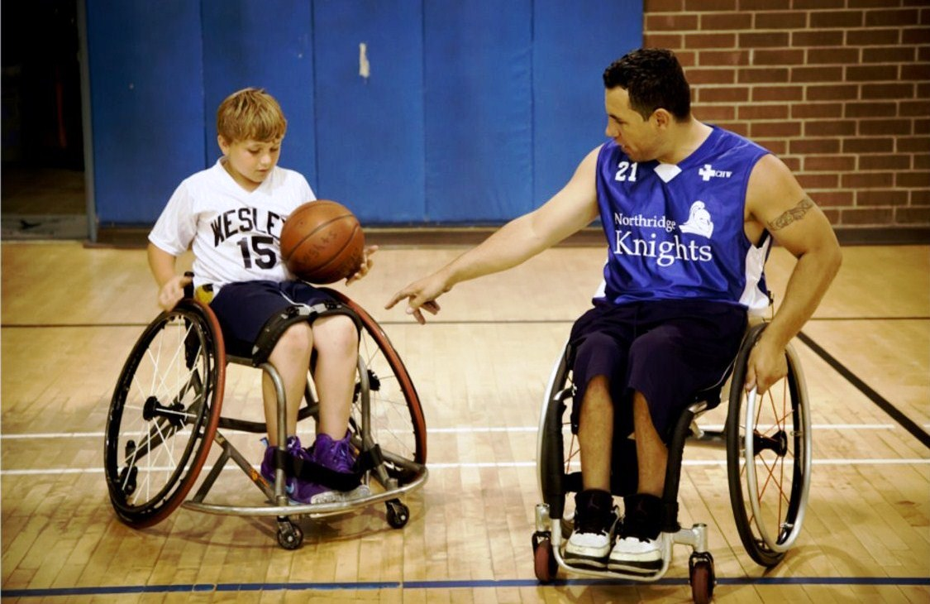
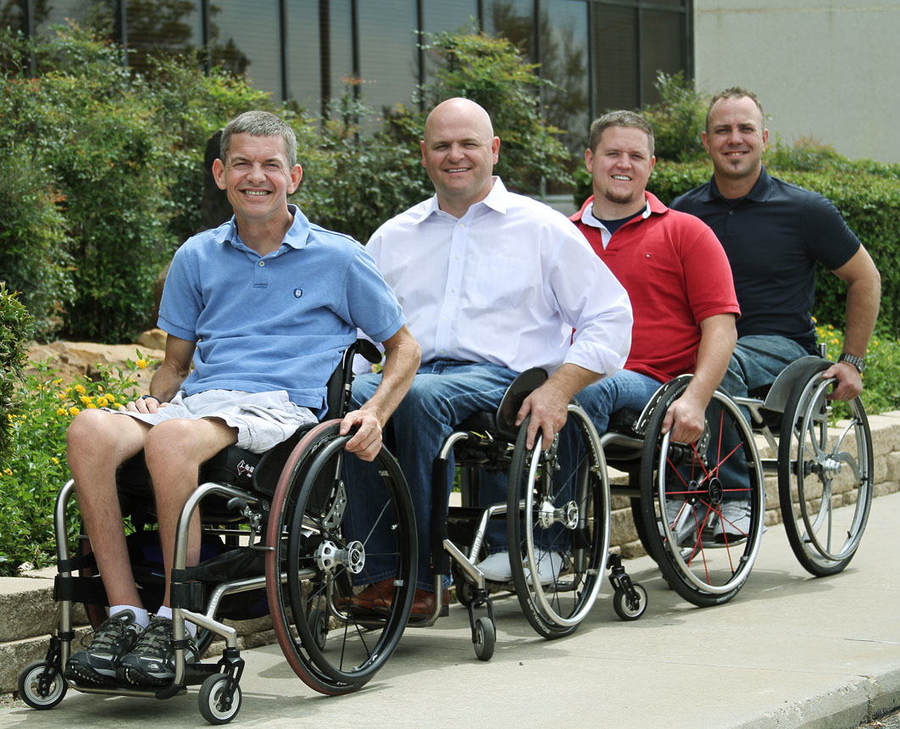
Spinal Cord Injury Awareness and Education
Christopher Shawn Gutierrez
Western University of Health Sciences
HSCI 5108 Instructional Media

Slide 2
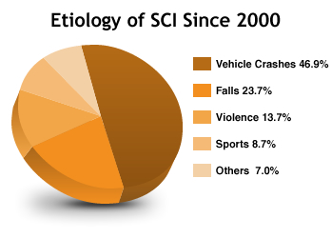
Who is affected by Spinal Cord Injuries (SCI)?
Around 12,500 new cases are reported every year
Current estimated number of individuals living with SCI is about 276,000
79% of spinal cord injuries occur in males (Hargrave, 2014)
The above chart shows various ways individuals may become afflicted with a spinal cord injury. It can happen to anyone for a variety of causes.

Slide 3
What is a Spinal Cord Injury?
An injury to the spinal cord which causes a change in normal movement, sensory (hot/cold sensation, touch) or autonomic (breathing, sweating, blood pressure) functions
Tetraplegia/Quadriplegia is an injury to the cervical region (neck) of the spinal cord and typically causes a loss of function in all extremities (arms and legs).
Paraplegia is an injury to the thoracic (ribs), lumbar (low back) or sacral (tailbone) segments of the spinal cord and typically cause a loss of function in the lower extremities (Harness & Feather, 2012).

Slide 4
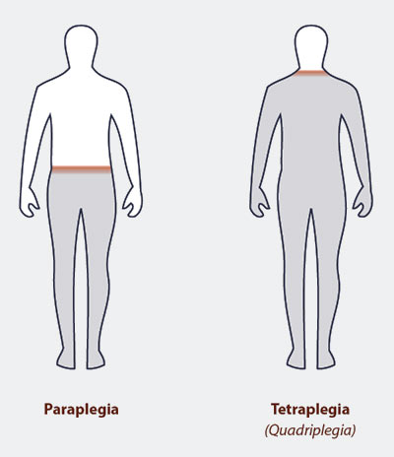
Quadraplegia and Paraplegia

Slide 5
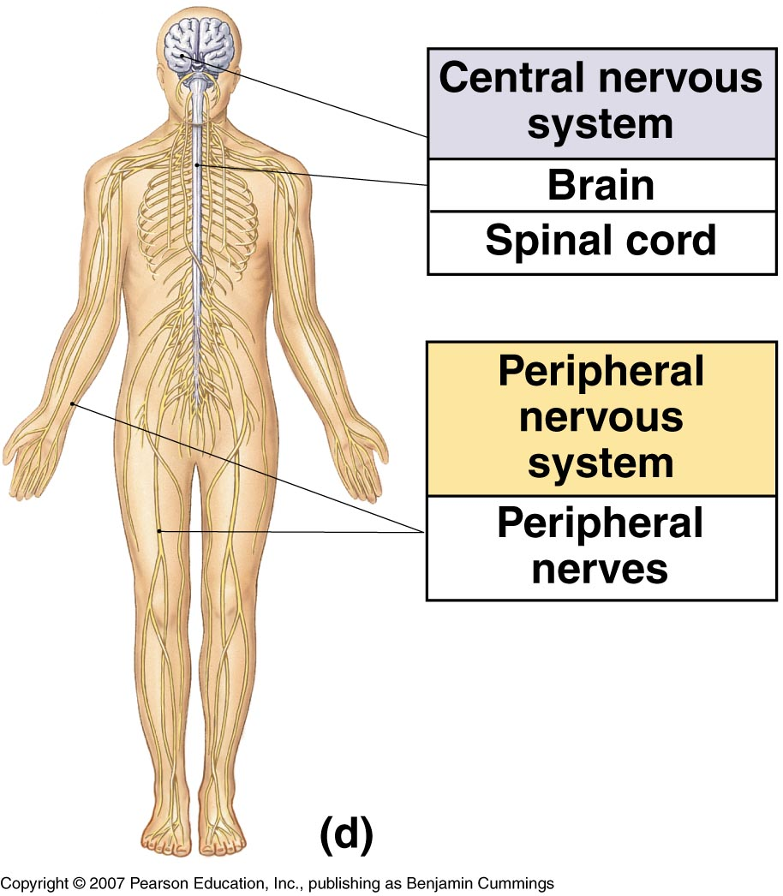

Spinal Cord Injury and the Nervous System
the spinal cord is part of the nervous system which is messaging system for movement, senses and reflexes
Messages sent along the spinal cord from the brain to the nerves affect skeletal muscles, heart muscles and digestive muscles (Harness & Feather, 2012)

Slide 6
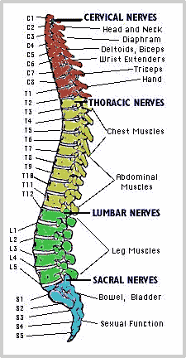
How are individuals affected by Spinal Cord Injury?
The picture gives a brief overview of how the body is affected by different levels of injury. To be noted, even at the same level, no two injuries present exactly the same.

Slide 7
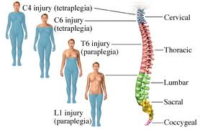
Paralysis
Paralysis to the limbs
  Paralysis is the most well known side effect of spinal cord injuries. Typically the higher the injury level, the greater loss of function that occurs
  Muscle loss (atrophy) is typical in SCI patients due to the inability to utilize their limbs

Slide 8
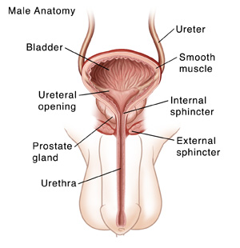
Bowel and Bladder Changes
Bowel and Bladder Function
  Typically, SCI individuals cannot feel when the bladder is full.
  Spontaneous emptying of the bladder may occur
Urinary Tract Infections are common in SCI people.
  UTI symptoms include cloudy, odorous urine, fever, chills and increased spasms

Slide 9
Bowel and Bladder Changes
Depending on the level of injury, (typically above T12) bowel movements may become reflexive (empty automatically when full).
When the injury is below T12 the bowels become more flaccid, which may cause unplanned bowel movements
With bowel and bladder issues it’s important to have a management program and a set schedule, to prevent accidents and infections (Harness & Feather, 2012).

Slide 10
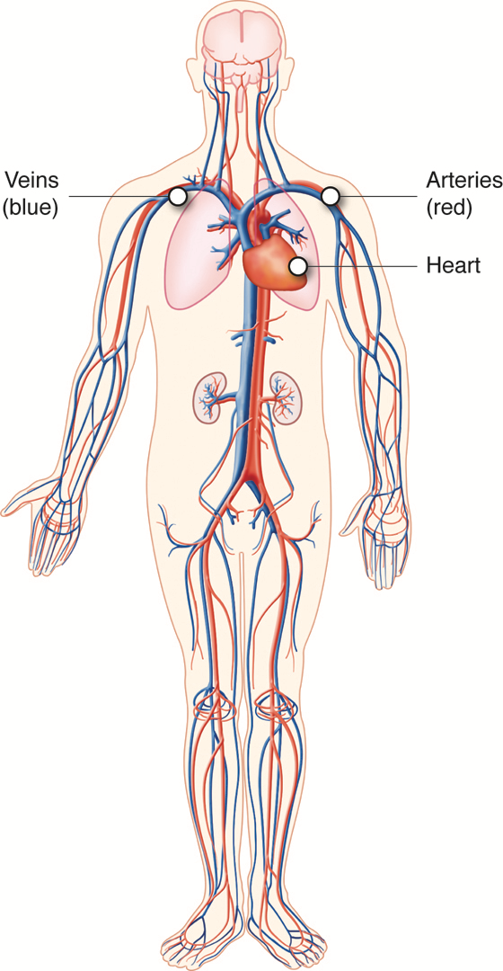
Blood Circulation Changes
Low Blood Pressure (Hypotension)
  Due to limb paralysis, blood tends to accumulate in the legs
  With changes in positioning, individuals with SCI may experience dizziness or possibly faint
Autonomic Dysreflexia
  Due to the lack of sensation, unpleasant stimuli may cause a dangerous rise in blood pressure
  If not handled promptly, stroke can occur and in severe cases, death (Harness & Feather, 2012)

Slide 11
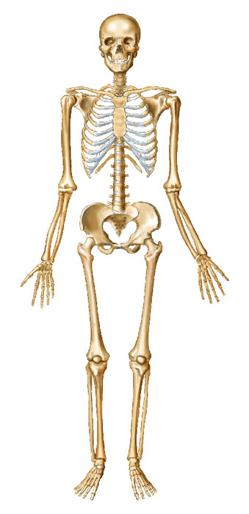
Skeletal Changes
Osteoporosis and Fractures
  Due to the lack of load bearing and muscle activity, spinal cord injury patients tend to have bone loss
  Excess bone loss leads to Osteoporosis and Osteopenia which increases the potential risk of fractures
Heterotopic Ossification
  In rare cases, the body will lay down excess bone around the joints which could limit the range of motion of that extremity. Can result in the need for surgical release of the affected area (Harness & Feather, 2012).

Slide 12
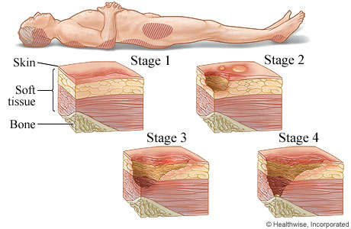
Skin Breakdown
Also called ulcers or pressure sores, skin breakdown is a dangerous and potentially deadly side effect of spinal cord injury
Prolonged pressure around bony areas (buttocks, tailbone, elbows, etc.) combined with changes in blood flow make patients with SCI particularly vulnerable to skin breakdown (Harness & Feather, 2012).

Slide 13

Secondary Complications
Inactivity can lead to several health issues
  High blood pressure
  Weight Gain/Obesity
  High Cholesterol
  Diabetes
  Muscle Loss
  Higher prevalence of depression (Howley & Franks, 2007)

Slide 14
Treatment Options for SCI
Exercise Based Therapies
  Rehabilitation is essential in recovery, longevity and quality of life
  Exercise helps prevent secondary complications of physical inactivity (Howley & Franks, 2007)
  The following is a link to different facilities throughout the United States: http://www.sci-info-pages.com/rehabs.html
  Another notable facility not listed is Project Walk: www.projectwalk.com

Slide 15
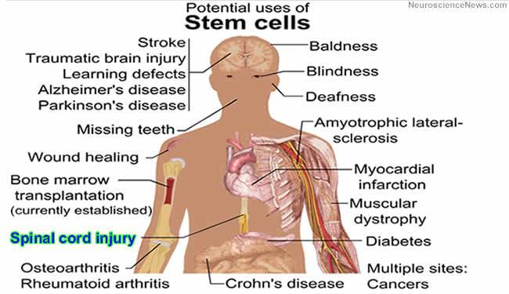
Treatment Options for SCI
Stem Cells
  Early stage cells with the ability to change into any other types of specialized body cells
  Different bodies of evidence suggest promising benefits in regards to spinal cord injury recovery and stem cell use
  Political processes have immensely slowed the research progress utilizing stem cells (Reeves Foundation, 2015)
  For more information visit: http://www.christopherreeve.org/site/c.ddJFKRNoFiG/b.4435071/k.7013/Stem_Cell_Research_Center.htm

Slide 16
Resources for SCI affected patients and families
Information about spinal cord injuries
  www.beperfectfoundation.com
  www.spinalcord.org
  www.paralysis.org
  www.wpinalcord.uab.edu
  www.sci.rutgers.edu
  www.projectwalk.com

Slide 17
References
Harness, E., & Feather, J. (2012). Spinal Cord Injury 101. In Project Walk Theory and Methodology. Carlsbad, CA: SCI Business Solutions.
Hargrave, H. (2014). Spinal Injury 101. Retrieved May 25, 2015 from : http://www.beperfectfoundation.com/index.php/spinal-injury-101
Stem Cell Primer. (2015). Retrieved May 24, 2015, from http://www.christopherreeve.org/site/c.ddJFKRNoFiG/b.4435093/k.A8D3/Stem_cell_primer.htm
Howley, E., & Franks, B. (2007). Fitness Professional's Handbook (5th ed., pp. 3-13,297-318). Champaign, Illinois: Human Kinetics.

